Slide 1




University of Information Technology and Communications
Business Informatics College
Businesses Information Technology (BIT)
HTML
Yasser alasady & dr. reem

Slide 2
Outline
HTML Lists
HTML supports ordered, unordered and definition lists.
1.Unordered Lists
An unordered list is a list of items. The list items are marked with bullets (typically small black circles).
An unordered list starts with the <ul> tag. Each list item starts with the <li> tag.
Here is how it looks in a browser:
<ul>
<li>Coffee</li>
<li>Milk</li>
</ul>

Slide 3
Outline
HTML Lists
2. Ordered Lists
An ordered list is also a list of items. The list items are marked with numbers.
An ordered list starts with the <ol> tag. Each list item starts with the <li> tag.
Here is how it looks in a browser:
<ol>
<li>Coffee</li>
<li>Milk</li>
</ol>

Slide 4
Outline
HTML Lists
3.Definition Lists
A definition list is not a list of single items. It is a list of items (terms), with a description of each item (term).
A definition list starts with a <dl> tag (definition list).
Each term starts with a <dt> tag (definition term).
Each description starts with a <dd> tag (definition description).
Here is how it looks in a browser:
<dl>
<dt>Coffee</dt>
<dd>Black hot drink</dd>
<dt>Milk</dt>
<dd>White cold drink</dd>
</dl>

Slide 5
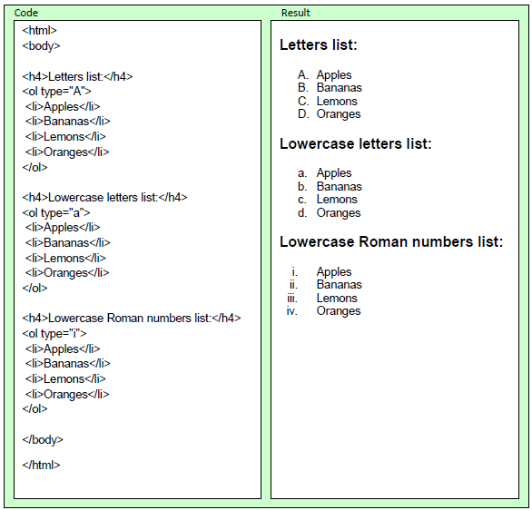
Outline
Examples
The following example demonstrates different types of ordered lists.

Slide 6
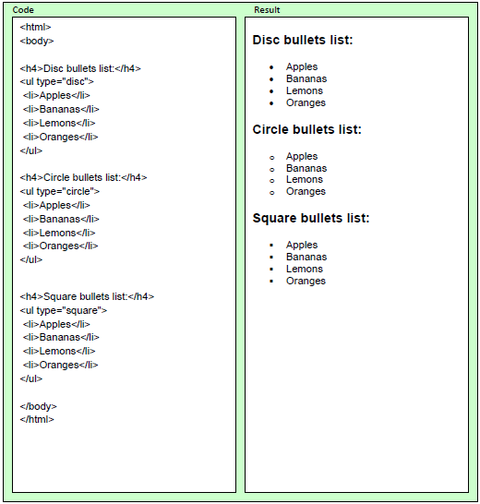
Outline
Examples
The following example demonstrates different types of unordered lists.

Slide 7
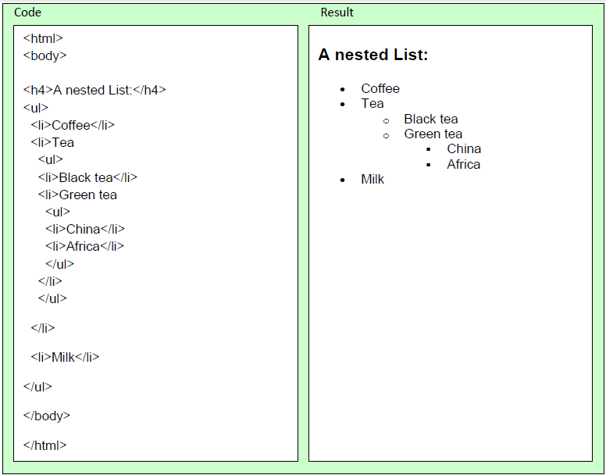
Outline
Examples
The following example demonstrates how you can nest lists.

Slide 8
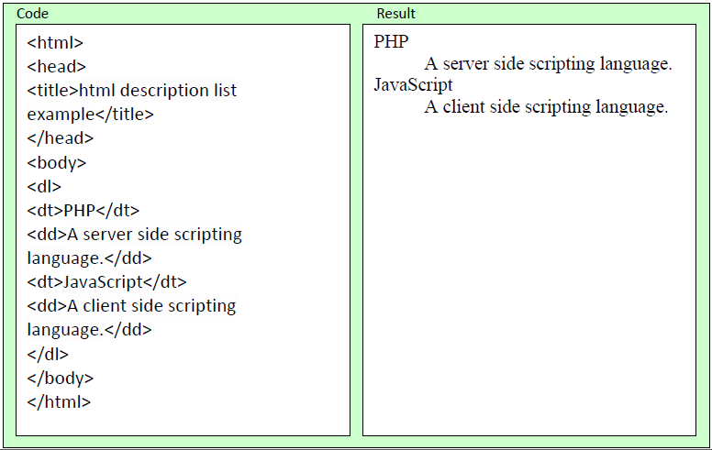
Outline
Examples

Slide 9
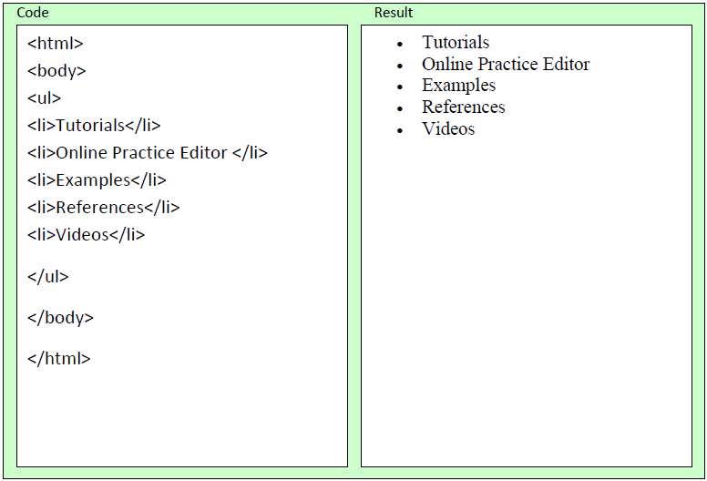
Outline
Examples

Slide 10

THANK YOU

